Slide 1
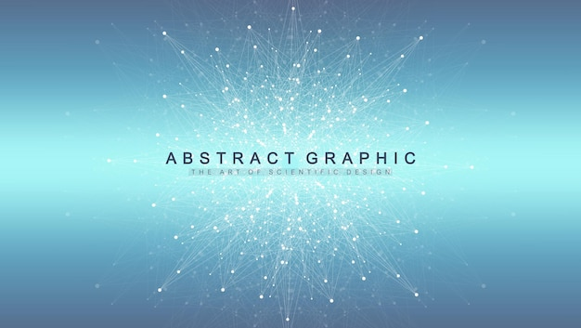
Comprehensive Reference Guide
Machine Learning
Algorithms
35 Essential Algorithms Across 5 Categories
Supervised Learning
Unsupervised Learning
Deep Learning

Slide 2
Overview
Contents
01
Supervised Learning
02
Unsupervised Learning
Regression and classification algorithms that learn from labeled data
Clustering and dimensionality reduction for pattern discovery
Linear Regression
Decision Trees
SVM
KNN
K-Means
DBSCAN
PCA
t-SNE
03
Deep Learning
04
Reinforcement Learning
Neural network architectures for complex pattern recognition
Algorithms that learn through environment interaction and rewards
CNN
RNN
LSTM
Transformers
Q-Learning
DQN
05
Ensemble Methods
XGBoost
AdaBoost
LightGBM
Techniques that combine multiple models for improved performance

Slide 3
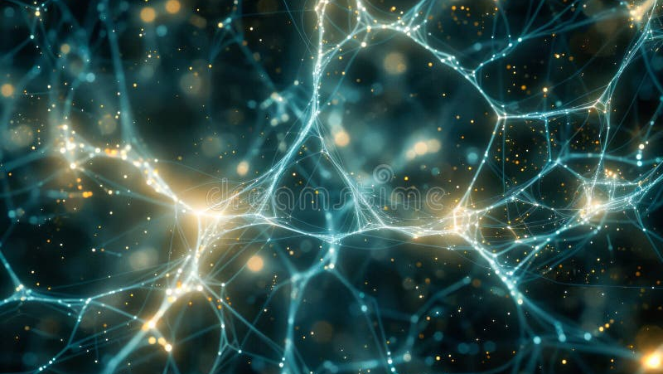
Chapter 01
Supervised
Learning
Algorithms that learn from labeled data to make predictions on new, unseen data
Regression
Classification

Slide 4
Supervised Learning
Regression Algorithms
Predict continuous numerical values based on input features
Linear Regression
Ridge Regression
Models linear relationship between independent and dependent variables by fitting a straight line. Simple yet powerful for predicting continuous outcomes.
Linear regression with L2 regularization that penalizes large coefficients. Prevents overfitting by adding a penalty term to the loss function.
Use Cases:
House price prediction, sales forecasting, trend analysis
Use Cases:
Multicollinearity problems, feature-rich datasets
Strengths:
Highly interpretable, fast training, works well with linear relationships
Strengths:
Handles multicollinearity, reduces model complexity
Limitations:
Assumes linearity, sensitive to outliers
Limitations:
Does not perform feature selection, requires tuning alpha
Lasso Regression
Logistic Regression
Linear regression with L1 regularization that can shrink coefficients to zero. Performs automatic feature selection by eliminating irrelevant features.
Classification algorithm using sigmoid function to predict probabilities. Despite its name, it's used for binary and multiclass classification tasks.
Use Cases:
High-dimensional data, feature selection, sparse models
Use Cases:
Spam detection, disease diagnosis, credit scoring
Strengths:
Automatic feature selection, creates sparse models
Strengths:
Fast, interpretable, provides probability estimates
Limitations:
Struggles with highly correlated features, selects only one
Limitations:
Assumes linear decision boundary, struggles with complex patterns

Slide 5
Supervised Learning
Classification Algorithms - Part 1
Algorithms that assign input data to predefined categories or classes
Decision Trees
Random Forest
Tree-like model that splits data based on feature values to make decisions. Each internal node represents a test on an attribute, each branch represents the outcome.
Ensemble of decision trees that combines predictions through majority voting. Each tree is trained on a random subset of data and features to reduce overfitting.
Use Cases:
Customer segmentation, medical diagnosis, fraud detection
Use Cases:
Credit scoring, stock market prediction, feature importance
Strengths:
Highly interpretable, handles non-linear relationships, no scaling needed
Strengths:
Reduces overfitting, handles high dimensionality, robust
Limitations:
Prone to overfitting, unstable with small data changes
Limitations:
Less interpretable than single trees, computationally expensive
Support Vector Machines
K-Nearest Neighbors
Finds optimal hyperplane that maximally separates different classes. Can use kernel tricks to handle non-linear decision boundaries in high-dimensional spaces.
Instance-based learning that classifies new data points based on the majority class of their k nearest neighbors in the feature space.
Use Cases:
Image classification, text categorization, bioinformatics
Use Cases:
Recommendation systems, image recognition, anomaly detection
Strengths:
Effective in high dimensions, versatile with kernels, memory efficient
Strengths:
Simple to understand, no training phase, works with any distance metric
Limitations:
Computationally intensive, sensitive to feature scaling
Limitations:
Slow prediction, sensitive to irrelevant features, requires scaling

Slide 6
Supervised Learning
Classification Algorithms - Part 2
Probabilistic and statistical approaches to classification
Naive Bayes
Linear Discriminant Analysis
Probabilistic classifier based on Bayes' theorem with strong independence assumptions between features. Despite its simplifying assumptions, it performs surprisingly well.
Supervised dimensionality reduction technique that finds linear combinations of features to maximize separation between classes while minimizing within-class variance.
Use Cases:
Spam filtering, sentiment analysis, document classification
Use Cases:
Face recognition, customer segmentation, medical diagnosis
Strengths:
Extremely fast, works well with high dimensions, handles missing values
Strengths:
Reduces dimensionality, handles multicollinearity, stable with small samples
Limitations:
Strong independence assumption rarely holds, zero frequency problem
Limitations:
Assumes Gaussian distributions, sensitive to outliers
Relationship:
Similar to PCA but uses class labels for supervised reduction
Variants:
Gaussian, Multinomial, Bernoulli, Complement
Key Insights
Naive Bayes excels with text data despite its simplifying assumptions
LDA provides both classification and dimensionality reduction
Both algorithms are fast and work well with limited training data

Slide 7
Chapter 02
Unsupervised
Learning
Algorithms that discover hidden patterns and structures in unlabeled data
Clustering
Dimensionality Reduction

Slide 8
Unsupervised Learning
Clustering Algorithms - Part 1
Group similar data points together based on feature similarity
K-Means
Hierarchical
DBSCAN
Partitions data into k clusters by minimizing within-cluster sum of squares. Iteratively assigns points to nearest centroid and updates centroids.
Creates tree of clusters (dendrogram) by merging or splitting clusters. Agglomerative (bottom-up) and divisive (top-down) approaches.
Density-based clustering that groups points in high-density regions and marks outliers. Does not require specifying cluster count.
Use Cases:
Customer segmentation, image compression, document clustering
Use Cases:
Taxonomy creation, gene expression analysis
Use Cases:
Anomaly detection, spatial data analysis
Strengths:
No need to specify k, provides hierarchy
Strengths:
Finds arbitrary shapes, identifies outliers
Strengths:
Simple, fast, scalable to large datasets
Limitations:
Computationally expensive, irreversible decisions
Limitations:
Struggles with varying densities, parameter sensitive
Limitations:
Requires k specification, sensitive to initialization
Clustering Algorithm Comparison
K-Means
Hierarchical
DBSCAN
• Requires specifying k
• No k required
• Auto-detects clusters
• Assumes spherical clusters
• Creates dendrogram
• Handles arbitrary shapes
• O(n*k*i) complexity
• O(n²) to O(n³) complexity
• O(n log n) complexity

Slide 9
Unsupervised Learning
Clustering Algorithms - Part 2
Advanced clustering techniques for complex data distributions
Gaussian Mixture
Spectral Clustering
Mean Shift
Probabilistic model assuming data generated from Gaussian distributions. Uses EM algorithm to estimate parameters and provides soft cluster assignments.
Uses eigenvalues of similarity matrix to reduce dimensionality before clustering. Effective for non-convex clusters and graph-based data.
Non-parametric clustering that finds dense regions by shifting points towards mode of density function. Automatically determines cluster count.
Use Cases:
Image segmentation, density estimation
Use Cases:
Image segmentation, social network analysis
Use Cases:
Image segmentation, object tracking
Strengths:
Soft clustering, handles overlapping clusters
Strengths:
Handles non-convex shapes, graph-based
Strengths:
No assumptions about cluster shape, finds modes
Limitations:
Assumes Gaussian distributions, slow convergence
Limitations:
Computationally expensive, memory intensive
Limitations:
Computationally expensive, bandwidth selection
Advanced Clustering Insights
Gaussian Mixture provides probabilistic cluster membership, useful when clusters overlap
Spectral Clustering excels with graph data and non-convex cluster shapes
Mean Shift automatically discovers cluster count without prior specification

Slide 10
Unsupervised Learning
Dimensionality Reduction
Techniques to reduce feature space while preserving essential information
Principal Component Analysis
t-SNE
Linear technique projecting data onto orthogonal axes (principal components) that capture maximum variance. First component captures most variance.
Non-linear technique that preserves local structure by converting similarities to probabilities. Excellent for visualizing high-dimensional data in 2D/3D.
Use Cases:
Data visualization, noise reduction, feature extraction
Use Cases:
Data visualization, cluster exploration
Strengths:
Computationally efficient, removes correlations, interpretable
Strengths:
Preserves local structure, reveals clusters
Limitations:
Linear only, sensitive to scaling, loses interpretability
Limitations:
Slow, stochastic, hyperparameter sensitive
UMAP
Apriori Algorithm
Uniform Manifold Approximation and Projection preserves both local and global structure using topological methods. Faster alternative to t-SNE.
Association rule mining that discovers frequent itemsets and generates rules. Uses downward closure property to reduce search space efficiently.
Use Cases:
Visualization, preprocessing for clustering
Use Cases:
Market basket analysis, recommendation systems
Strengths:
Fast, preserves global structure, scalable
Strengths:
Easy to implement, interpretable rules
Limitations:
Hyperparameter sensitive, less established
Limitations:
Slow with large datasets, generates many rules

Slide 11
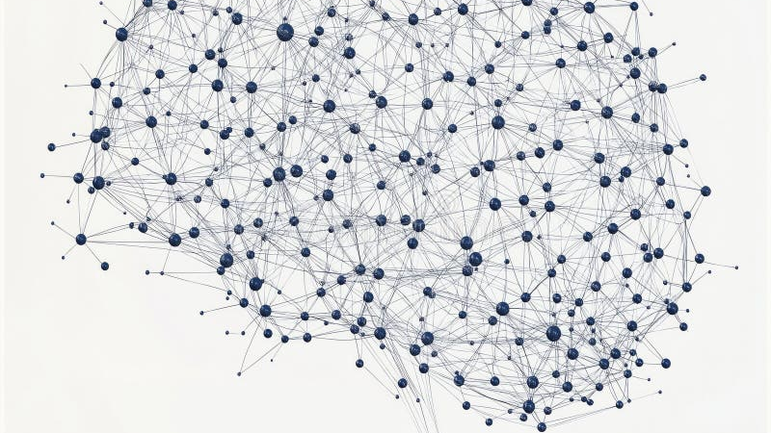
Chapter 03
Deep
Learning
Neural network architectures that learn hierarchical representations from data
Neural Networks
Computer Vision
NLP

Slide 12
Deep Learning
Neural Network Architectures
Fundamental deep learning models for various data types and tasks
Neural Networks
Convolutional Neural Networks
Feedforward networks with input, hidden, and output layers. Each neuron applies weighted sum followed by activation function to learn non-linear mappings.
Specialized for grid-like data using convolutional layers with filters that learn spatial hierarchies. Pooling layers reduce dimensionality and provide translation invariance.
Use Cases:
Function approximation, pattern recognition
Use Cases:
Image classification, object detection
Strengths:
Universal approximator, flexible architecture
Strengths:
Parameter sharing, translation invariant
Limitations:
Requires large data, prone to overfitting
Limitations:
Requires large datasets, computationally intensive
Recurrent Neural Networks
LSTM & GRU
Designed for sequential data with connections that form directed cycles. Maintains hidden state that captures information about previous inputs in the sequence.
Advanced RNN variants with gating mechanisms. LSTM uses input, forget, and output gates. GRU simplifies with update and reset gates while maintaining performance.
Use Cases:
Time series prediction, language modeling
Strengths:
Handles variable-length sequences, memory of past inputs
Use Cases:
Machine translation, speech recognition
Limitations:
Vanishing gradients, slow training, limited long-term memory
Strengths:
Solves vanishing gradients, captures long-term dependencies
Limitations:
Still sequential, slower than feedforward networks

Slide 13
Deep Learning
Advanced Deep Learning
Cutting-edge architectures pushing the boundaries of AI capabilities
Transformers
GANs
Autoencoders
Attention-based architecture that processes sequences in parallel using self-attention mechanisms. Captures long-range dependencies without recurrence.
Generative Adversarial Networks consist of generator and discriminator networks competing against each other. Generator creates synthetic data while discriminator evaluates authenticity.
Unsupervised networks that learn compressed representations by encoding input to latent space then decoding back. Learn efficient data codings automatically.
Use Cases:
NLP, machine translation, text generation
Use Cases:
Dimensionality reduction, denoising, anomaly detection
Strengths:
Parallelizable, captures global context, scalable
Use Cases:
Image synthesis, style transfer, data augmentation
Limitations:
Quadratic memory, requires large data
Strengths:
Unsupervised learning, learns meaningful representations
Strengths:
Generates realistic data, unsupervised learning
Key Models:
BERT, GPT, T5, Vision Transformer
Limitations:
Training instability, mode collapse
Limitations:
May learn identity function, sensitive to architecture
Variants:
DCGAN, CycleGAN, StyleGAN
Variants:
VAE, Denoising AE, Sparse AE
Impact on Modern AI
Transformers revolutionized NLP and are expanding to computer vision and multimodal tasks
GANs enable creation of photorealistic images, videos, and synthetic training data
Autoencoders provide powerful unsupervised feature learning and data compression

Slide 14

Chapter 04
Reinforcement
Learning
Algorithms that learn optimal strategies through interaction with environments
Autonomous Agents
Game Playing

Slide 15
Reinforcement Learning
Reinforcement Learning Algorithms
Learning through trial and error with reward-based feedback
Q-Learning
Deep Q-Networks
Model-free algorithm that learns action-value function (Q-function) through temporal difference updates. Agent learns optimal policy by exploring environment and updating Q-values based on rewards.
Combines Q-learning with deep neural networks to approximate Q-function. Uses experience replay and target networks to stabilize training in complex environments with continuous state spaces.
Use Cases:
Game playing, robot navigation, resource management
Use Cases:
Atari games, robotics, autonomous driving
Strengths:
Model-free, off-policy, guaranteed convergence
Strengths:
Handles high-dimensional states, end-to-end learning
Limitations:
Struggles with large state spaces, requires exploration
Limitations:
Sample inefficient, unstable training, overestimation bias
Key Concept:
Q-table stores expected future rewards for state-action pairs
Innovation:
Neural network replaces Q-table for continuous states
Core Concepts in Reinforcement Learning
Agent
Environment
Reward
Policy
Learner and decision maker
World agent interacts with
Feedback signal from environment
Strategy mapping states to actions

Slide 16
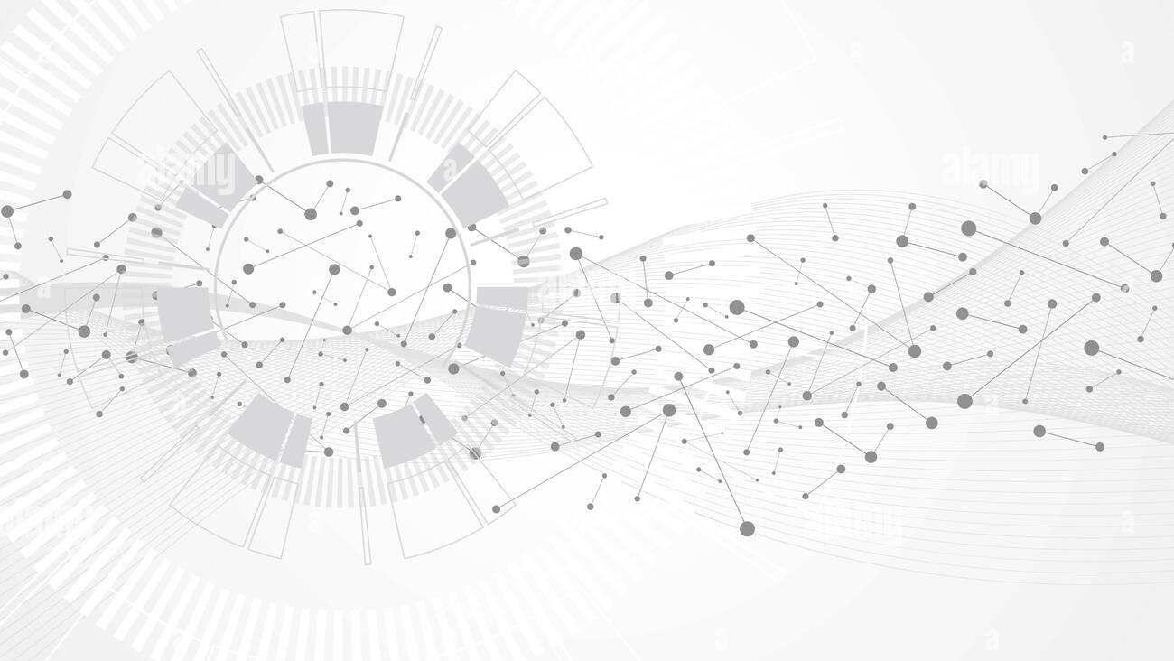
Chapter 05
Ensemble
Methods
Combining multiple models to achieve superior performance and robustness
Boosting
Bagging

Slide 17
Ensemble Methods
Boosting Algorithms
Sequential model building that corrects errors of previous models
Gradient Boosting
XGBoost
Builds trees sequentially where each new tree fits residuals of previous ensemble. Uses gradient descent to minimize loss function.
Extreme Gradient Boosting with regularization, parallel processing, and built-in cross-validation. Dominates structured data competitions.
Use Cases:
Regression, classification, ranking
Use Cases:
Kaggle competitions, structured data
Strengths:
High accuracy, handles mixed data types
Strengths:
Regularization, fast, handles missing values
Limitations:
Prone to overfitting, sequential training
Limitations:
Many hyperparameters, can overfit
LightGBM
CatBoost
Light Gradient Boosting Machine uses leaf-wise tree growth and histogram-based algorithms. Faster and more memory-efficient than XGBoost.
Categorical Boosting automatically handles categorical features using ordered boosting. Reduces prediction shift and provides robust results.
Use Cases:
Large datasets, real-time applications
Use Cases:
Datasets with categorical features
Strengths:
Fast training, low memory, handles large data
Strengths:
Handles categorical data, reduces overfitting
Limitations:
Can overfit with leaf-wise growth
Limitations:
Slower than LightGBM, newer library
AdaBoost
Adaptive Boosting focuses on misclassified samples by adjusting weights. Combines weak learners into strong classifier through weighted voting.
Use Cases:
Face detection, text classification
Strengths:
Simple, resistant to overfitting
Limitations:
Sensitive to noisy data, outliers

Slide 18

Algorithm Selection Guide
35 algorithms across 5 categories. Choose based on your data type, problem complexity, and performance requirements.
Supervised
Unsupervised
Deep Learning
Reinforcement
Ensemble
6 algorithms
10 algorithms
8 algorithms
2 algorithms
5 algorithms
Regression & Classification
Clustering & Reduction
Neural Architectures
Learning by Interaction
Model Combination
Key Principles for Algorithm Selection
Start with Your Data
Define Your Goal
Balance Complexity
Understand data type, size, quality, and whether labels are available
Clarify whether you need prediction, clustering, generation, or control
Start simple, iterate, and validate. More complex isn't always better
"The goal is to turn data into information, and information into insight."
— Carly Fiorina

